Slide 1
Chapter 2 Configuration Space
Chapter 3 Rigid-Body Motions
Chapter 4 Forward Kinematics
Chapter 5 Velocity Kinematics and Statics
Chapter 6 Inverse Kinematics
Chapter 7 Kinematics of Closed Chains
Chapter 8 Dynamics of Open Chains
8.1 Lagrangian Formulation
8.2 Dynamics of a Single Rigid Body
Chapter 9 Trajectory Generation
Chapter 10 Motion Planning
Chapter 11 Robot Control
Chapter 12 Grasping and Manipulation
Chapter 13 Wheeled Mobile Robots

Slide 2
Important concepts, symbols, and equations
dynamics of a rigid body:
inertia matrix
symmetric, positive definite
(x^{T} I_{b} x > 0 for all x ≠ 0)

Slide 3
Important concepts, symbols, and equations (cont.)

Slide 4
Important concepts, symbols, and equations (cont.)
kinetic energy of a rotating body:
e-vals: λ₁, λ₂, λ₃
e-vecs: v₁, v₂, v₃
principal moments
of inertia
for coordinate axes along v₁, v₂, v_{3,}
the principal axes of inertia

Slide 5
Important concepts, symbols, and equations (cont.)
The inertia matrix of a compound body is the sum of their inertias when expressed in a common frame.
Frame at different orientation:
Aligned frame at q in {b} (Steiner’s theorem):
{c}
{b}
q
{q}
{b}

Slide 6
Important concepts, symbols, and equations (cont.)
spatial inertia matrix: ∈ ℝ^{6×6}
kinetic energy:
rigid-body dynamics:
where the “little adjoint” of a twist is
spatial inertia matrix in a frame {a}:
the form of the dynamics is independent of the frame!

Slide 7
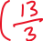

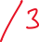
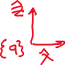

A compound object consists of a
uniform-density cylinder and a uniform-
density rectangular prism. The mass
of the cylinder is 2 kg and the mass of
the prism is 1 kg. A frame {a} is defined at the center of the cylinder, with the
x-axis along the prism and the z-axis vertical.
Where is the CM of the compound object in {a}?
In a frame {b} at the CM, aligned with {a}, what is the inertia of the compound
object?

Slide 8
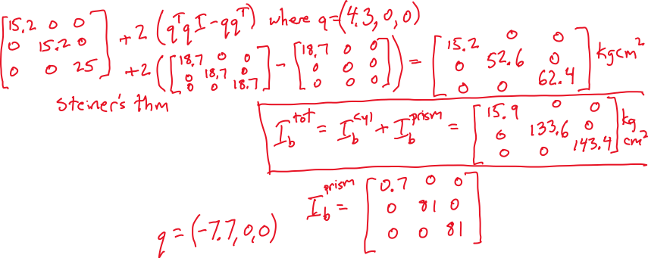

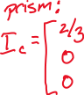
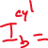
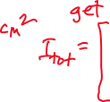
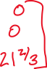

Slide 9
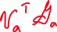



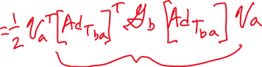

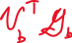
Derive
using equivalence of kinetic energy in different frames.

